Slide 1
Business Case

Slide 2
Business Case
PRINCE2® manual page 21
Workbook page 27
Notes:
2 hours is allocated to this topic, with 13 slides
Trainer-led exercise is to demonstrate the creation of a Business Case, then to get delegates to create a Business Case from a chosen scenario.

Slide 3
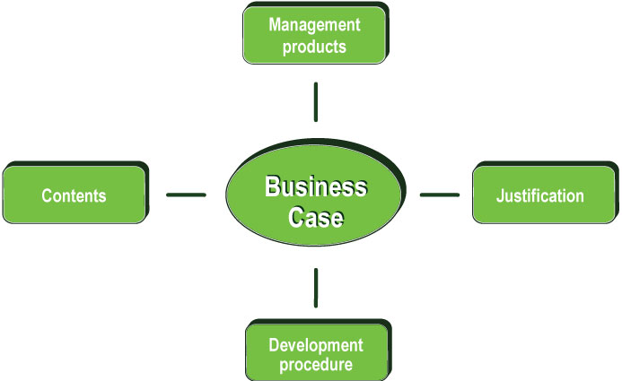
Business Case
Information hierarchy

Slide 4
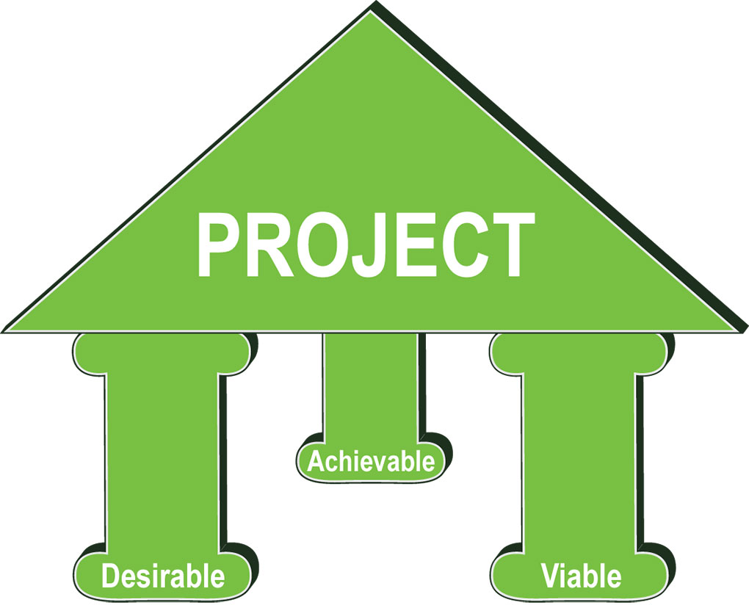
Business Case
Introduction
Is a project desirable, achievable and viable?
Balanced against benefits, risk, level of investment
Continued business justification
Just ask DAVe!
Notes:
D, A, V, e e = executive

Slide 5



Manual 235
Workbook 33
Manual 237
Workbook 31
Business Case
Management products
Benefits Review Plan
  Defines how and when benefits can be measured
Business Case
  Describes business justification on benefits, costs and risks.

Slide 6

Business Case
Development path

Slide 7
Business Case
Development path
Develop the Business Case
  Performed by Executive or nominee
  Executive is responsible for completion and approval
  If from programme management it is refined.
Maintain the Business Case
  Ensure decision making is well-informed
  Updated with actuals and current forecasts
  Maintained by Project Manager during:
  impact assessments of issues and risks
  each stage end and the final stage.

Slide 8
Business Case
Development path
Verify the Business Case
  Drives all decision making
  Executive ensures project is desirable, achievable & viable
  Verified by Project Board at each Directing a Project activity.
Confirm benefits
  Benefits Review Plan confirms benefits are realised
  Benefits can be reviewed during and after the project.

Slide 9
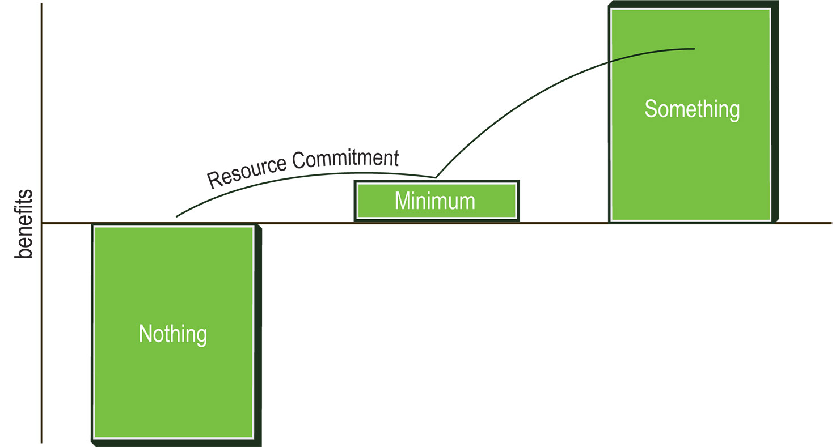
Business Case
Contents
Business options
  Do nothing, minimum or something more.

Slide 10

Business Case
Contents
Expected benefits
  Financial or non-financial
Output, outcome and benefits
  Output; any of the project's products, tangible or intangible
  Outcome; result of change derived from using the outputs
  Benefits; measurable improvement resulting from the outcome.

Slide 11
Business Case
Contents
Expected dis-benefits
  Accepted negative consequences affecting stakeholder(s) as a result of doing the project
Timescale
  Period of project
  Period that the cost/benefit analysis should be based
  Earliest/latest feasible start date
  Earliest/latest feasible completion date
  To help identify tolerances and timings for benefit reviews

Slide 12
Business Case
Principles
Continued business justification
Learn from experience
Defined roles and responsibilities
Manage by stages
Manage by exception
Focus on products
Tailor to suit project environment
Notes:
Tailor to suit the project environment
PRINCE2 is tailored to suit the project’s environment, size, complexity, importance, capability and risk.
See workbook page 5 for explanation of what the principles mean
See workbook page 52 for specific links from change to the PRINCE2 principles.

